Slide 1
Synod of the Sun
Personnel & Transition Comm.
Rev. Kevin Keaton, Regional Representative
1-800-773-7752, ext. 7044
kkeaton@pensions.org

Slide 2
The Board of Pensions
…is called and committed to the mission of the PC(USA), providing for the Church resources that proclaim, promote and sustain Christ’s gift of abundant life. The provision of these resources – including benefits, assistance, and educational resources – sustains wholeness for those who serve the Church, and strengthens the Church for its mission.
Notes:
…

Slide 3
Benefits by Classification
Identify which Positions (not persons) are Exempt and Non-Exempt (DOL)
Part-Time and Full Time
Identify which Positions (not persons) and employment classifications qualify for which Benefits

Slide 4
Design Objectives
Provide for a single plan.
Preserve existing benefits for installed pastors.
Adopt language and Plan terminology consistent with the Book of Order.
Modernize plan provisions.
Reinforce the importance of holistic health
Develop a Medical Plan pricing model that is sustainable and transparent
Notes:
With the Theology of Benefits as a foundational context, the design objectives guided the redesign:
Single plan –with a menu of Employer Benefit Options
Preserve all existing benefits for installed teaching elders - with pricing that supports community nature and is expressed as a percentage of effective salary.
- Adopt language consistent with the Book of Order
- Modernize plan provisions where it is appropriate
- Reinforce holistic health – echoing CREDO – spiritual, physical & emotional, financial, and vocational well-being
Develop a pricing model that is sustainable and transparent

Slide 5
Who Will Be Eligible?
Installed Teaching Elders will be enrolled in Pastor’s Participation.
Other Teaching Elders may be enrolled in either Pastor’s Participation or in menu options.
Other Employees will be eligible to enroll in menu options selected by the employer.
  Require a working-hour minimum of 20 hours per week for all benefits except the RSP.
  Employers will be able to implement grandfathering provisions for Other Employees.

Slide 6
Pastor’s Participation
Benefits for installed pastors, Pastor’s Participation, includes the following, without regard to number of hours worked:
- Defined Pension Benefits
- Death and Disability
- Preferred Provider Organization Medical
(PPO)
Dues will be on a non-contributory % basis.

Slide 7
Other Employees
The plan design includes provisions that will enable Employers to make decisions about
What benefits will be offered?
Who, in addition to installed pastors, will be eligible for benefits?
How much employees will contribute toward the cost of coverage?

Slide 8
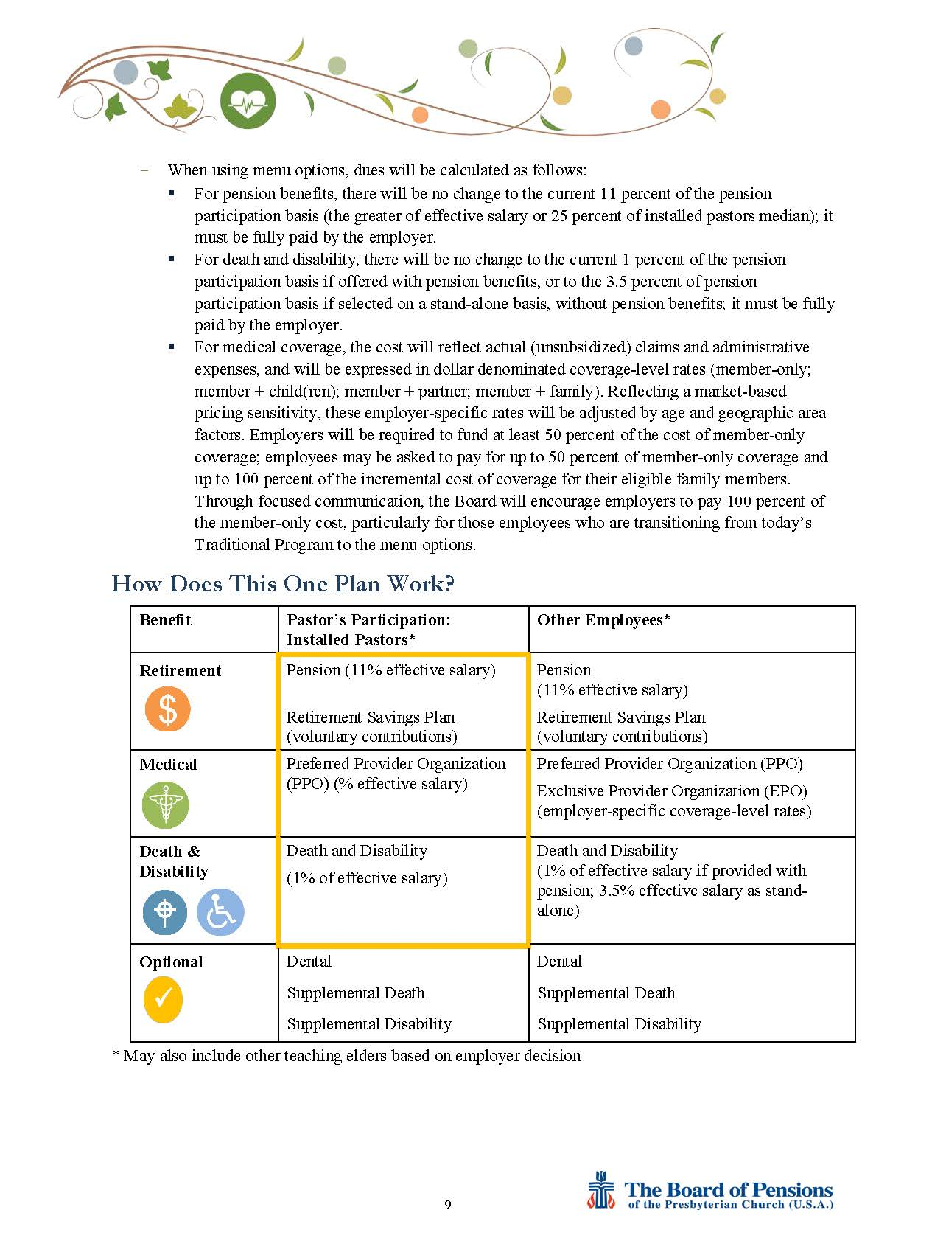
What Benefits?

Slide 9
How much ?
  Pastor’s Participation on % basis.
  Medical Dues for Other Employees - expressed as fixed dollar amounts - coverage level pricing -calculated on a regional pricing model
There will be a transitional pricing structure for some existing employers in the Traditional Plan, which limits increases in family coverage costs.

Slide 10
Cost Sharing?
Employers will be required to fund at least 50 percent of the cost of member-only coverage.
Employees may be asked to pay for up to 50 percent of member-only coverage and up to 100 percent of the incremental cost of coverage for their eligible family members.
Pastor’s Participation is non-contributory and restores Call Neutrality .

Slide 11
When?
Act on Proposed Plan Design by the Board of Directors
– March, 2016
Interpretation and Communication
  Regional Benefits Consultations
  Local Gatherings of Large Employers
  General Assembly
Redesigned Benefits Plan
– Effective 1/1/17

Slide 12
Tax Advantaged Plans
Tax Advantaged Plan Resources
  http://www.pensions.org/availableresources/taxadvantagedplans/Pages/default.aspx
Section 125 Plans
  Web Module providing overview of Section 125 Plans
  Employer Guide to Tax Advantaged Plans
  Sample Documents
  Note: Flexible Spending Arrangements only may be offered when an employer-paid qualified healthcare plan is in place.

Slide 13

Retirement Savings Plan
Any W-2 employee of an eligible employing organization may participate
Contributions may be made by employee, employer, or both
Fidelity Investments is record keeper
  Annual fee of $15
  www.fidelity.com
    “How Much Do I Need to Retire?”

Slide 14
Employee Assistance Program
Cigna: Employee Assistance Program
  Confidential counseling/referral service
    866-640-2772
    24 hours/7days a week access
  For members and household members
  Six free sessions per person per issue
    Stress, personal issues, substance abuse, legal, financial, legal help, and life events

Slide 15
Management consultation
Management consultation services are available through EAP to church leaders/other managers who need assistance with a difficult management or employee performance issue.
Management consultation services broad categories:
  Informal referrals;
  Formal Management Referrals;
  Critical Incident Response services;
  Guidance for other concerns.
Referral to the EAP can be mandatory and a condition of the employee’s continued employment.
Call 866-640-2772. Employee assistance consultants are licensed master’s degree-level clinicians with backgrounds in theology: Dan Ahlfield & Pam Meier

Slide 16

Who?
    Members act in 2016 to qualify for 2017
When?
    complete health actions between October 1, 2015 - September 30, 2016
How tracked?
  via Benefits Connect
Why???
  Lower Deductible!!!
Notes:
Invite but not require covered partners participation
Adopt Wholeness / Well-being theme
Add physical and spiritual components

